Slide 1
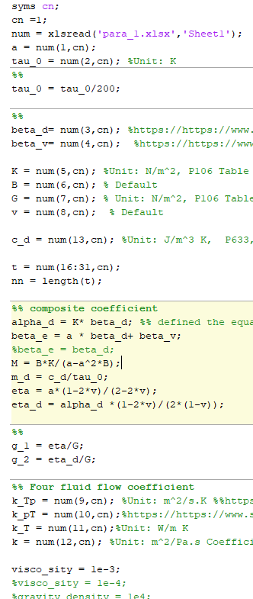
09.04.2022

Slide 2
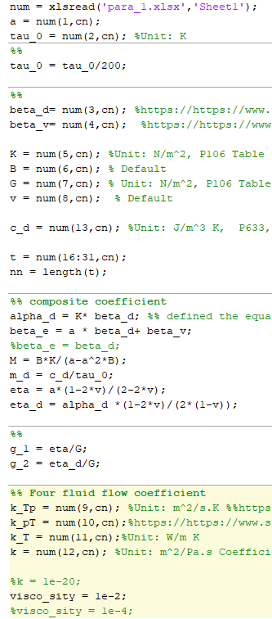
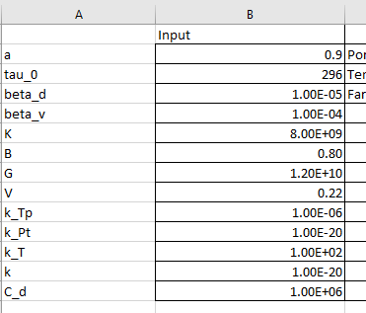
09.04.2022

Slide 3
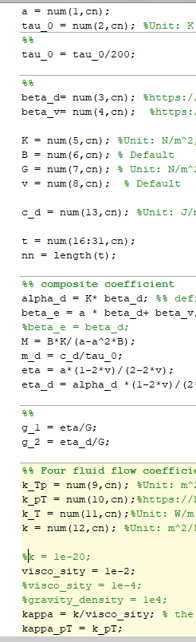
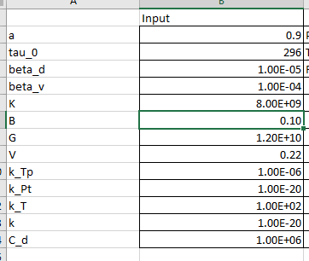
09.04.2022

Slide 4
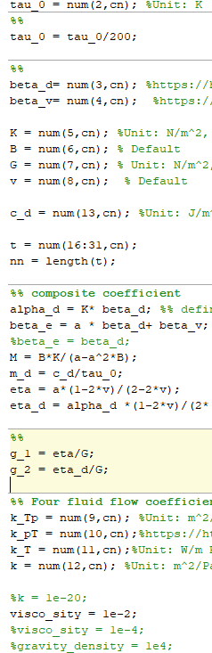
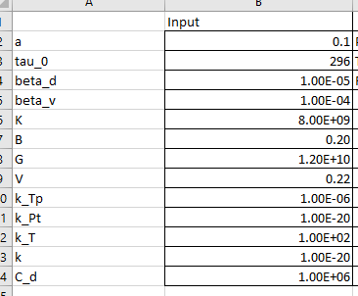
09.04.2022

Slide 5
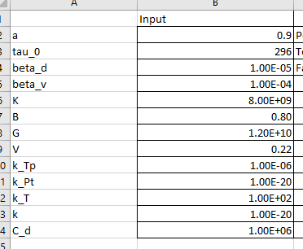
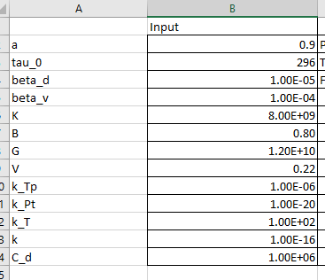
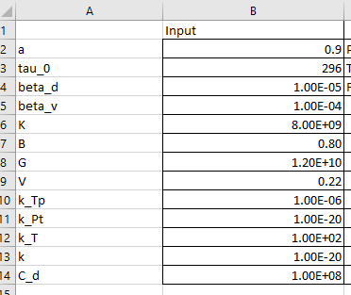
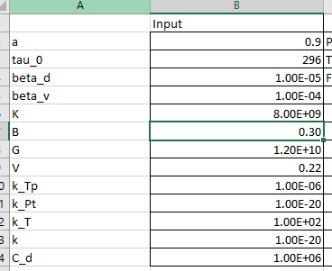
09.04.2022
zeta11_simple =
-7.205963866553230
zeta11_complex = -0.496534977884805
zeta11_simple = 0.006336927000657
zeta11_complex = 4.366530233010611e-04
zeta11_simple =
0.705373499160877
zeta11_complex =
0.048604547745797

